Slide 1





Teddy Takes A Walk

Slide 2
This is Finlay and this is Teddy.
Finlay always takes his Teddy everywhere.
Every time they go out walking he always holds Teddy’s hand.
Notes:
This is Finlay and this is Teddy. Finlay always takes his Teddy everywhere. Every time they go out walking he always holds Teddy’s hand.

Slide 3
  Today Finlay is excited. It is his first day back at school after the holidays and he can’t wait to see all his friends again.
Finlay loves walking to school and talks about the things he sees on his journey, like Chris the postman posting the letters and Lucy the lollipop lady helping children across the road.
Notes:
Today Finlay is excited. It is his first day back at school after the holidays and he can’t wait to see all his friends again. Finlay loves walking to school and talks about the things he sees on his journey, like Chris the postman posting the letters and Lucy the lollipop lady helping children across the road.

Slide 4
Mummy says, “Make sure you have your coat and wellies on today as it has been raining”.
Notes:
Mummy says, “Make sure you have your coat and wellies on today as it has been raining”.

Slide 5
Mummy, Finlay and Teddy hold hands and set off on their walk to school.
On the way Chris the postie waves to them and says, “Good morning”.
Notes:
Mummy. Finlay and Teddy hold hands and set off on their walk to school. On the way Chris the postie waves to them and says, “Good morning”.

Slide 6
A big yellow bus passes them. It is taking some children to school. Finlay spots some people digging the road and it is very noisy as they walk past.
Notes:
A big yellow bus passes them. It is tsking some children to school. Finlay spots some people digging the road and it is very noisy as they walk past,

Slide 7
As they get near the corner Finlay sees his friend Oscar on the other side of the road.
Finlay lets go of Teddy’s hand so he can wave to Oscar and he drops Teddy very close to the road!
Just then a car comes to the corner and splashes through a great big puddle!
Notes:
As they get near the corner Finlay sees his friend Oscar on the other side of the road. Finlay lets go of Teddy’s hand so he can wave to Oscar and he drops Teddy very close to the road! Just then a car comes to the corner and splashes through a great big puddle!

Slide 8
The water hits Teddy who is too close to the road.
Poor Teddy! He is soaking wet and has hurt his knee and his elbow.
Teddy is very upset and scared by what has happened.
Notes:
The water hits Teddy who is too close to the road. Poor Teddy! He is soaking wet and has hurt his knee and his elbow. Teddy is very upset and scared by what has happened.

Slide 9
“Teddy is very lucky he didn’t fall into the road Finlay”,
says his mummy,
“You should always keep hold of Teddy’s hand”.
Notes:
“Teddy is very lucky he didn’t fall into the road Finlay”, says his mummy, “You should always keep hold of Teddy’s hand”.

Slide 10
Finlay picks up Teddy and holds his hand as they walk towards school.
Mummy says they should find a safer place to cross the road like a puffin crossing or a zebra crossing.
Notes:
Finlay picks up Teddy and holds his hand as they walk towards school. Mummy says they should find a safer place to cross the road like a puffin crossing or a zebra crossing.

Slide 11
As they get nearer the school they see there are lots of parked cars. It is not a good idea to cross between parked cars.
They move further up the road to where Lucy the Lollipop Lady helps people to cross more safely.
Notes:
As they get nearer the school they see there are lots of parked cars. It is not a good idea to cross between parked cars so they move further up the road to where Lucy the Lollipop Lady helps people to cross more safely

Slide 12
Finlay, Teddy and Mummy stop at the kerb and wait until Lucy the lollipop lady has stopped all the traffic and tells them it is safe to cross.
Before they go Mummy reminds Finlay that they should always look and listen for traffic whenever they cross the road.
As Finlay goes past Lucy he says, “Thank you” and gives her a big smile.
Notes:
Finlay, Teddy and Mummy stop at the kerb and wait until Lucy the lollipop lady has stopped all the traffic and tells them it is safe to cross. Before they go Mummy reminds Finlay that they should always look and listen for traffic whenever they cross the road. As Finlay goes past Lucy he says, “Thank you” and gives her a big smile.

Slide 13
Finlay, Teddy and Mummy arrive safely in the playground.
Finlay gives Teddy a big hug and whispers, “I will always hold your hand and keep you safe from now on”.
Notes:
Finlay, Teddy and Mummy arrive safely in the playground. Finlay gives Teddy a big hug and whispers, “I will always hold your hand and keep you safe from now on”.

Slide 14
Always hold hands with your grown up …..
and your teddy!
Notes:
Always hold hands with your grown up …..and your teddy!

Slide 15
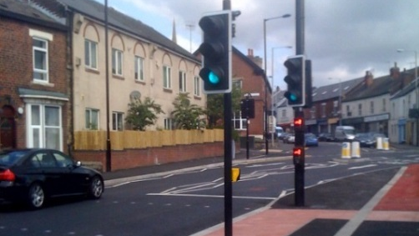
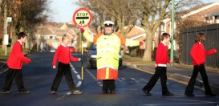
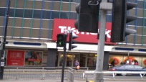
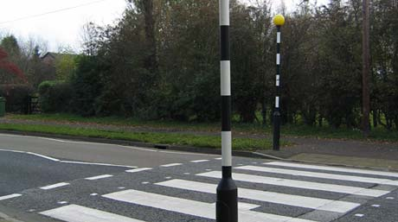
Puffin Crossing
Lollipop Person
Pelican Crossing
Zebra Crossing
Notes:
How many of these safer places to cross do you see on your way to school? And do you know what they are called?

Slide 16
Subway
Pedestrian Island
Footbridge
Police Officer
Notes:
And what about these?

