Slide 1

Getting Started

Slide 2

Congratulations on becoming the JRSOs for your school.
Your job is to share road safety messages with other children in your school to try and help keep them safer on the roads.
Lets get you started…

Slide 3

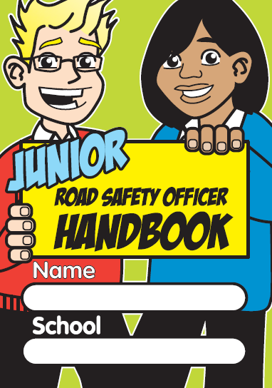

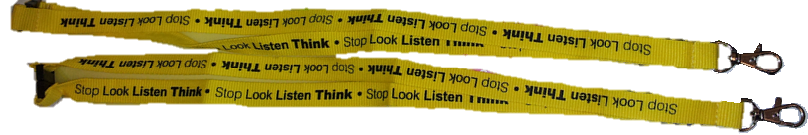

JRSO Pack
In your JRSO folder you have:
Handbook
ID Cards
Lanyards
JRSO Poster
Pencils
Stickers

Slide 4
JRSO Handbook
Your handbook is there to guide you throughout the school year. Each month has a different theme which you can work on in school.
You can change when you cover a topic or choose to miss it out if you need too.
The blank pages are there for you to make notes.

Slide 5
ID Cards & Lanyards
Your ID cards and lanyards are there for you to wear when you are doing your JRSO duties.
Maybe you could laminate your ID card and punch a hole through it to hang it around your neck.

Slide 6
JRSO Poster
Place your JRSO poster on your Junior Road Safety Officer Notice Board.
Don’t forget to write your names on so that everyone in school knows who to talk too about road safety.

Slide 7
Pencils and Stickers
The pencils and stickers are for you to use.
Maybe you could use your stickers on your notice board or when you are sending messages to the school. It is up to you.

Slide 8
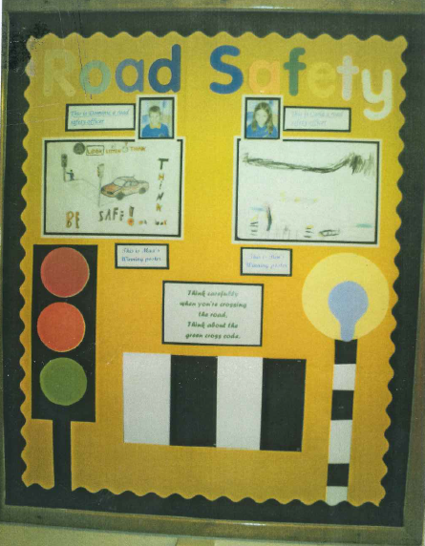
Notice Board
If you haven’t already been given a notice board to use - ask your teacher!
Give your board a clear title like ‘Junior Road Safety Officer’ so that everyone who sees it knows what it is about.
Make it bright, colourful and clear so that it catches attention as people walk past.
Aston Hall School
Rotherham

Slide 9

Assemblies
Now that you have made a start it is a good to introduce your selves to everyone.
Ask your teacher if you can take part in an assembly to say hello to everyone and tell them what you are going to be doing.
You can use assemblies later to share your road safety messages with everyone.

Slide 10
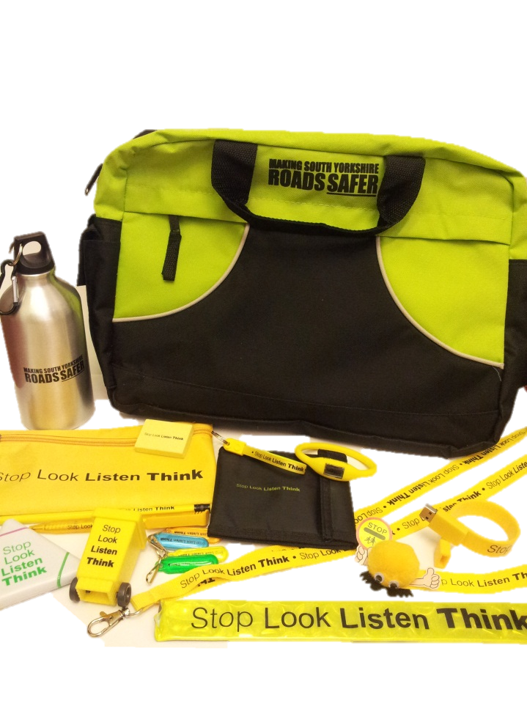
Sharing your messages
There are many ways you can choose to share your road safety messages in school.
JRSO noticeboard, assemblies, competitions, and newsletters are just some of the possibilities.
If you decide to run a competition in school remember that we can help you out with some prizes.
Prizes available for
in-school competitions

Slide 11
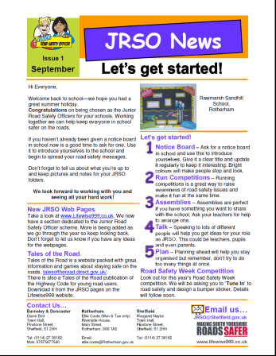
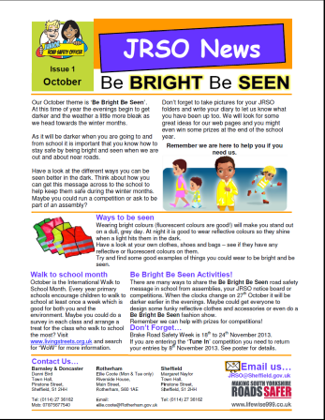

Help and resources
Every half term you will be sent our JRSO newsletter which will give you ideas on how to share the monthly topics in school.
We will tell you about posters, leaflets and websites that will help you.
These will all be added to the Junior Road Safety Officer pages on the Lifewise website.
www.lifewise999.co.uk/road-safety/junior-road-safety-officer

Slide 12

Things to remember…
You can use your JRSO folder to keep pictures, notes and copies of your road safety work in. Your work could win you prizes!
Talk to people in teacher, parents and children to see if they have any ideas for you to cover.
Don’t try to do too much at once and plan ahead to make things easier for you.

Slide 13

Finally…
Remember that your Road Safety Officers are here to help you when you need it.
If you want us to visit school ask your adult helper to contact us to make an appointment.
We look forward to seeing you all soon…good luck!

